Slide 1
Modularity and Functions
Christopher Mar

Slide 2
Instructions in Memory
.org assembler directive indicates where following instructions are located
Each instruction is assembled directly to a single 32-bit word that is located in RAM
CPU View

Slide 3
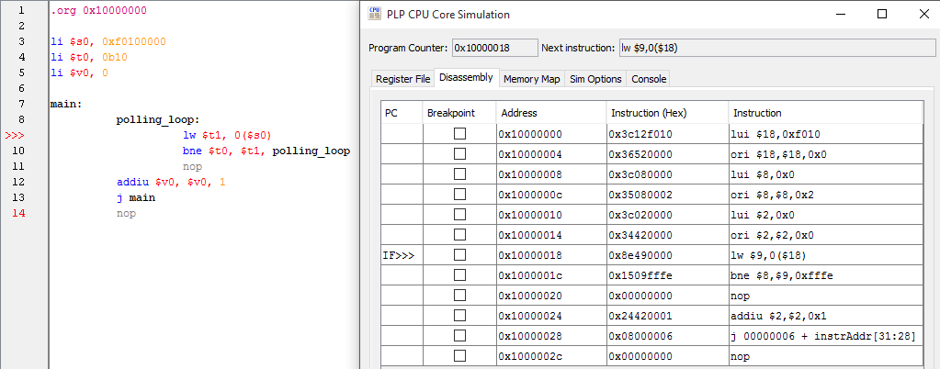
Instructions in Memory

Slide 4
Load Word (lw)
li $s0, 0x10000000
lw $t0, 4($s0)
Address | Contents
0x10000000 | 0x3C12f010
0x10000004 | 0x36520000
0x10000008 | 0x3C080000
0x1000000C | 0x35080002
$s0
Copied
$t0

Slide 5
Store Word (sw)
li $t0, 0x250
sw $t0, 8($s0) # $s0 = 0x10000000
Address | Contents
0x10000000 | 0x3C12f010
0x10000004 | 0x36520000
0x10000008 | 0x00000250
0x1000000C | 0x35080002
$s0
Copied
$t0

Slide 6
Jump-And-Link
jal label
Performs a jump to label just like j instruction
Stores address of next instruction in register $ra
Return address

Slide 7
Jump Register
jr $rs
Performs a jump j to the address stored in $rs
Typically used to return to where jal jumped from

Slide 8
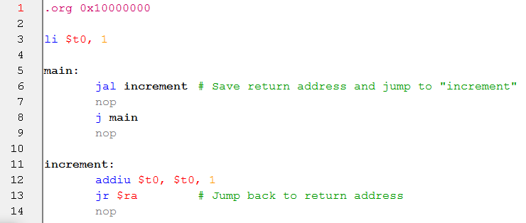
jal/jr Example

Slide 9
Stack
In PLP is implemented with:
Stack pointer ($sp)
Push pseudo-op
Pop pseudo-op
Stack grows upwards in memory (address gets smaller) so start at the bottom

Slide 10
Stack
Initialization:
li $sp, 0x10FFFFFC
This is the largest address mapped to RAM

Slide 11
Stack
li $sp, 0x10FFFFFC
Address | Contents
0x10FFFFF0 | 0x00000000
0x10FFFFF4 | 0x00000000
0x10FFFFF8 | 0x00000000
0x10FFFFFC | 0x00000000
$sp

Slide 12
Stack
push $t1 # Assume $t1 has 0x59
Address | Contents
0x10FFFFF0 | 0x00000000
0x10FFFFF4 | 0x00000000
0x10FFFFF8 | 0x00000000
0x10FFFFFC | 0x00000059
$sp
Copied
$t1

Slide 13
Stack
push $t1 # a second push
Address | Contents
0x10FFFFF0 | 0x00000000
0x10FFFFF4 | 0x00000000
0x10FFFFF8 | 0x00000059
0x10FFFFFC | 0x00000059
$sp
Copied
$t1

Slide 14
Stack
pop $t2
Address | Contents
0x10FFFFF0 | 0x00000000
0x10FFFFF4 | 0x00000000
0x10FFFFF8 | 0x00000059
0x10FFFFFC | 0x00000059
$sp
Copied
$t2

Slide 15
Stack
pop $t3 # a second pop
Address | Contents
0x10FFFFF0 | 0x00000000
0x10FFFFF4 | 0x00000000
0x10FFFFF8 | 0x00000059
0x10FFFFFC | 0x00000059
$sp
Copied
$t3

Slide 16
Stack
Notice that even though things have been popped, they are still in memory
Address | Contents
0x10FFFFF0 | 0x00000000
0x10FFFFF4 | 0x00000000
0x10FFFFF8 | 0x00000059
0x10FFFFFC | 0x00000059
$sp

Slide 17
PLPTool Memory Visulizer
Stack and other memory can be viewed with memory visualizer in simulation mode
Simulation → Tools → Create a PLP CPU Memory Visualizer

Slide 18
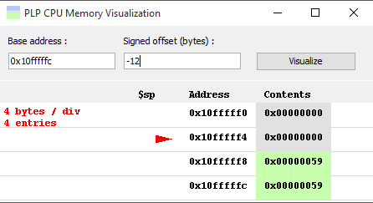
PLPTool Memory Visulizer

Slide 19
Call
call label
Saves current registers to stack
Including return address
Jumps to label
NOTE: the stack pointer must be initialized in order to use call without receiving an error

Slide 20
Return
return
Restores registers from stack
Jumps to the return address

Slide 21
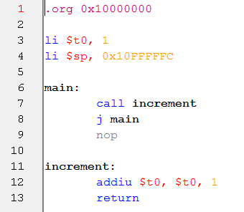
Call and Return Example

Slide 22
PLP Datapath

